Slide 1

COVID-19 Vaccines Analysis
Name-T.muzammil
Gmail-tmuzammil55@gmail.com
Collage name-Sri Ranganathar Institute of Engineering and Technology(SRIET)
Course Name-Applied data science

Slide 2
Phase-II
Innovation

Slide 3
Framework
This research presents a framework for sentiment analysis of COVID-19 vaccines. We have used python as a programming language and several libraries for text mining that will be explained.

Slide 4

The innovation to solve the problem
Importing the necessary Python libraries and the dataset
Pre process the Data
Prepare the Data
Machine learning Techniques.

Slide 5
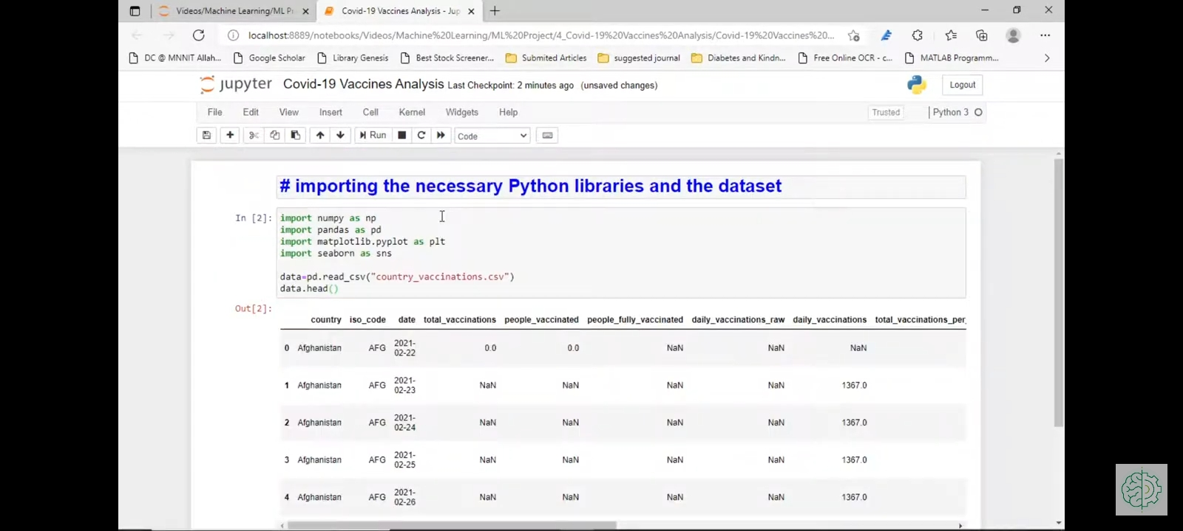

# Importing the necessary Python libraries and the dataset

Slide 6
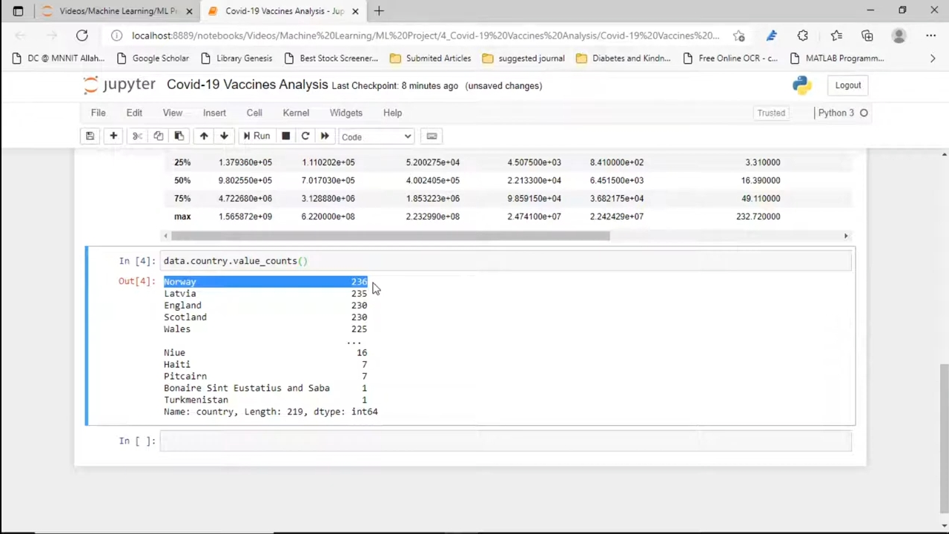

Slide 7
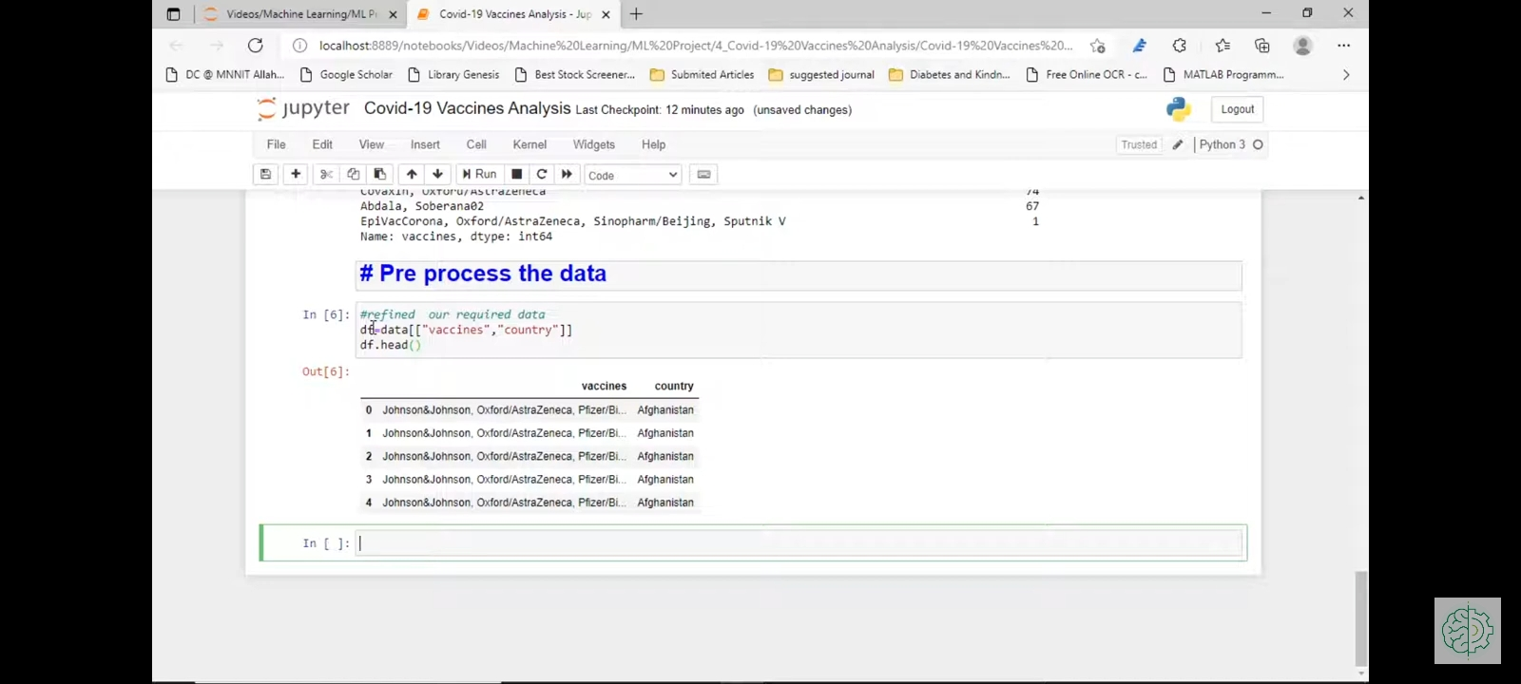
# Pre process the data

Slide 8
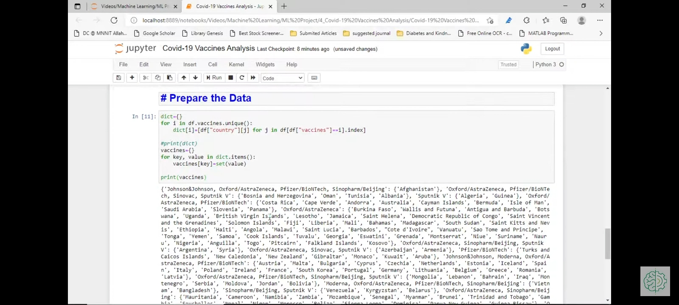
# Prepare the Data

Slide 9
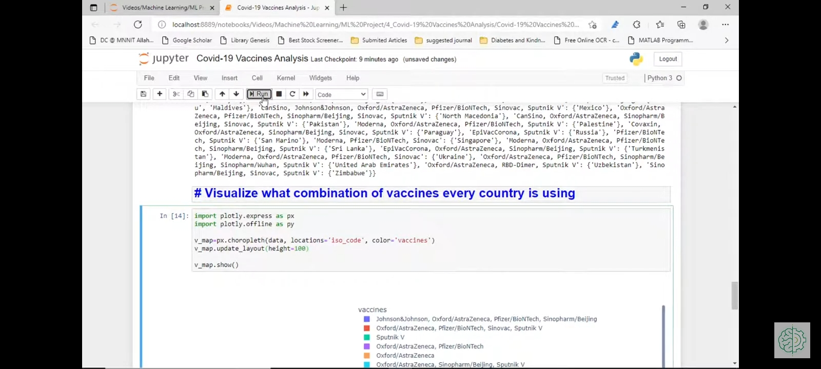
# Visualize what combination of vaccines every country is using

Slide 10
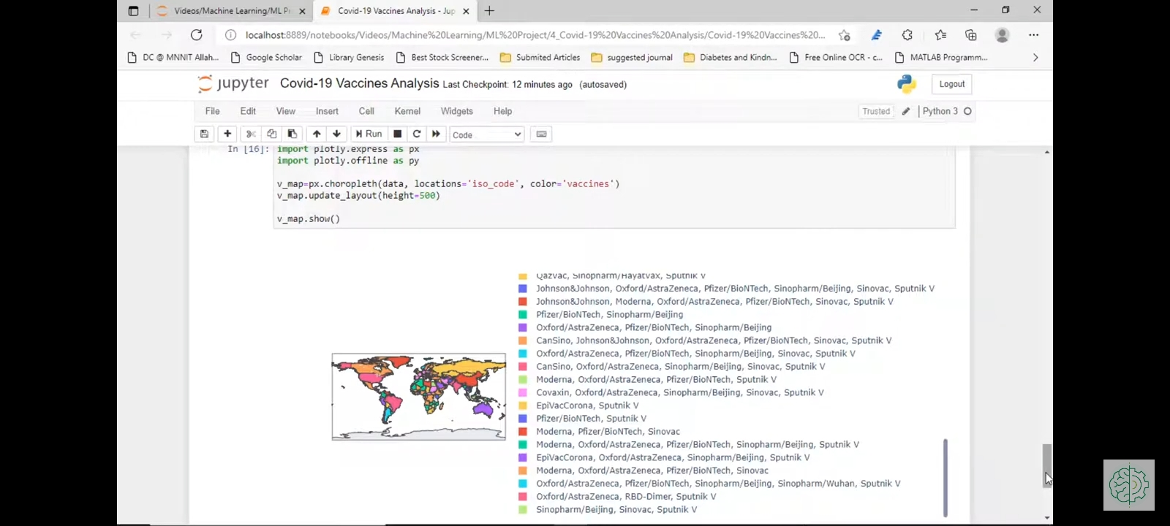

Slide 11
Machine learning
Machine learning (ML) is a popular use of artificial intelligence since it automates the system and allows it to learn and improve from diverse experiences without being programmed. Computer programs can teach how to learn by giving them access to data and allowing them to utilize it for learning in ML. The learning process in ML begins with seeing the data through examples or instructions that humans offer; these observations enable ML to look for patterns in order to make the best predictions. Five different ML models were used to train the classifier and evaluate classification performance using the test dataset. These are discussed below.

Slide 12
Machine learning Techniques
Random Forest
Naive Bayes
Decision Tree
Logistic Regressions
Support Vector Machine

Slide 13
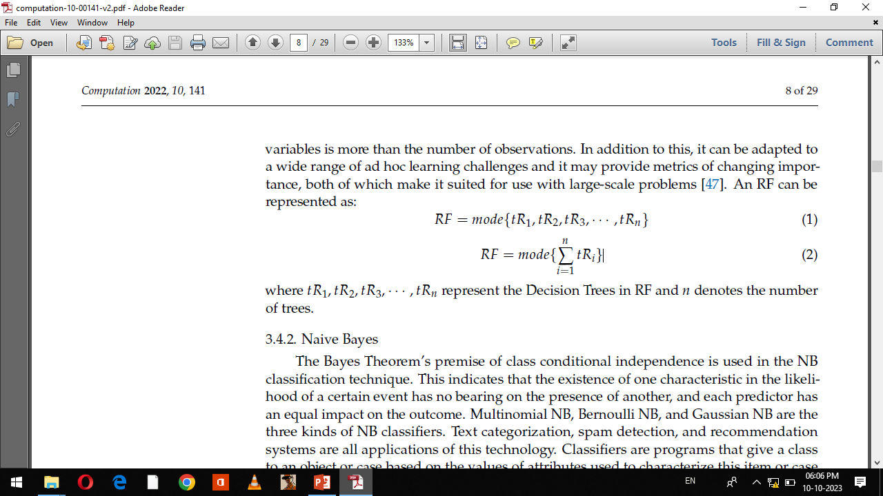
Random Forest
The RF model is an ensemble model that generates high-precision predictions by combining the results obtained from several sub-trees. The supervised ML method known as RF may be used for both classification and regression analysis
An RF can be represented as:
where tR1, tR2, tR3,... , tRn represent the Decision Trees in RF and n denotes the number of trees.

Slide 14
Naive Bayes
The Bayes Theorem’s premise of class conditional independence is used in the NB classification technique. This indicates that the existence of one characteristic in the likelihood of a certain event has no bearing on the presence of another, and each predictor has an equal impact on the outcome. Multinomial NB, Bernoulli NB, and Gaussian NB are the three kinds of NB classifiers. Text categorization, spam detection, and recommendation systems are all applications of this technology.
An NB can be represented as:
P(A\B)=P(B\A) P(A)
P(B)

Slide 15
Decision Tree
DTs are a technique for non-parametric supervised learning that may be used for classification and regression. DT is a model for ML that may be used for the problem solving process of regression as well as classification. The purpose of this project is to build a model that can accurately forecast the value of a target variable by gleaning fundamental decision rules from the features of the data. A DT with multiple branches of varying sizes is used in conjunction with partitioning the dataset into an incremental method of construction.

Slide 16
Logistic Regression
Logistic Regression is a statistical approach to data analysis in which one or more variables are utilized to determine the outcome. When the target variable is categorical, the optimum learning model to utilize is LR, which is the regression model that was used to estimate the likelihood of class members. Linear Regression uses a logistic function to estimate probabilities for the association between the categorical dependent variable and one or more independent variables.

Slide 17
Support Vector Machine
A support vector machine(SVM), which was created by Vladimir Vapnik, is a supervised learning model that can be used to both classify and regress data [51]. On the other hand, the most popular use for it is in the realm of classification problems; in this context, it
is used to generate a hyperplane on which the distance between two classes of data points
is maximized.
Types of SVM
-> Linear SVM
-> Nonlinear SVM

Slide 18
Results and Discussion
This section presents the accuracy results of sentiment analysis carried out using five distinct methods applied to two distinct datasets, with the second dataset being further subdivided into five distinct vaccination datasets. The accuracy, precision, recall, F1 score, and support measurement are derived from the Random Forest, Naive Bayes, Decision Tree, Logistic Regression, and Support Vector Machine (SVM).

Slide 19
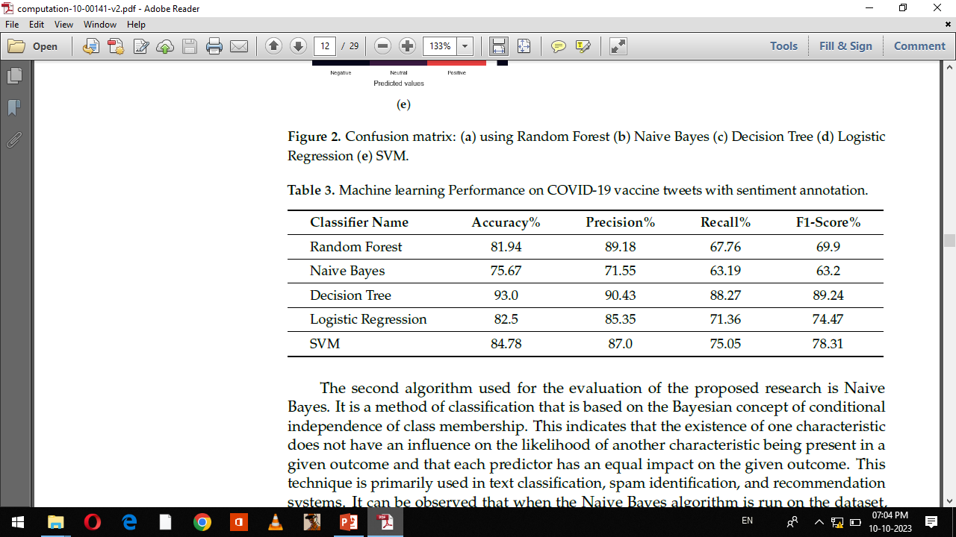
Machine learning Performance on COVID-19 vaccine analysis

Slide 20
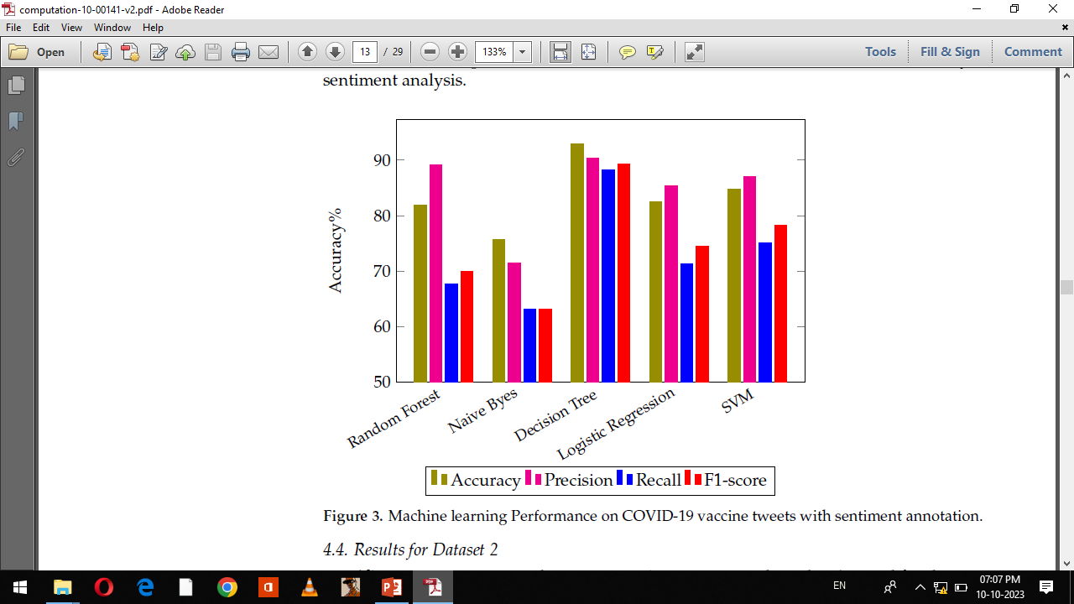
Bar Chart

